Slide 1
CALCULATOR USING PYTHON(Tkinter) presented by: Himanshu sharma

Slide 2
Introduction 1. python is a programming language . It is used for web developing website
And software , task automation, data analysis , and data visualization.
2. Python has been adopted by many non- programmers, such as accountants and scientists,for a variety of everyday tasks, like organizing.

Slide 3
Tools and Libraries used Used following libraries to work on this project 1. python 2. Tkinter 3. GUI hub 4.GUI base 5.GUI Repository

Slide 4
Basic steps:- . first we create an object named root out of tkinter. . Initialize the main window of your application. root = tk.Tk() root.title(“Simple calculator”) . Create an entry widget that will act as the display for the calculator. . Write functions to handle operations like addition, subtraction, multiplication, division.

Slide 5
SETTING UP THE GUI LAYOUT 1. Create an input field using ‘Tk.Entry’ to display the input and result. 2.Create buttons for digits(0-9) and operations(+,-,*, /) 3. use the tkinter to many other functions like(sine , cosine , log etc

Slide 6
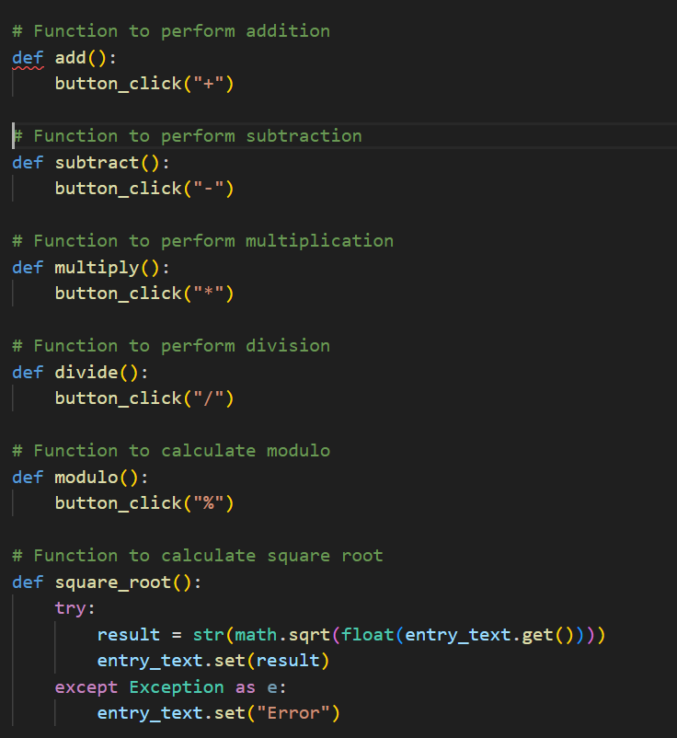
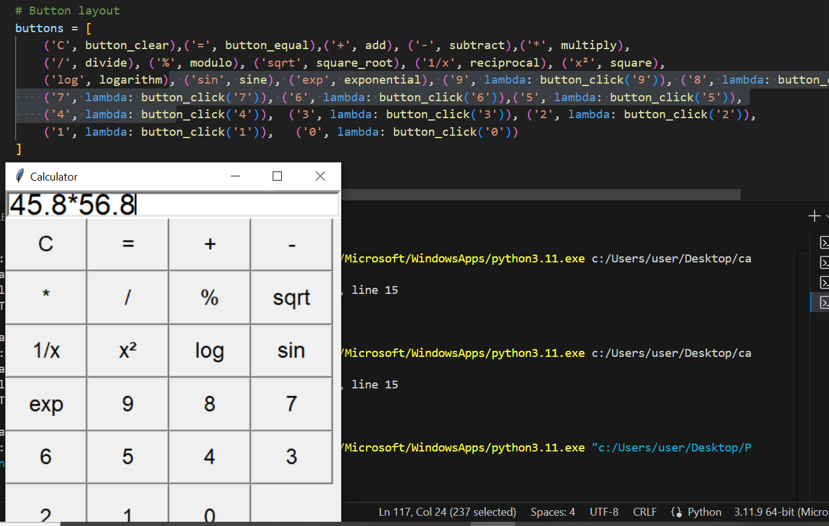
KRY “ Keys Representation”

Slide 7
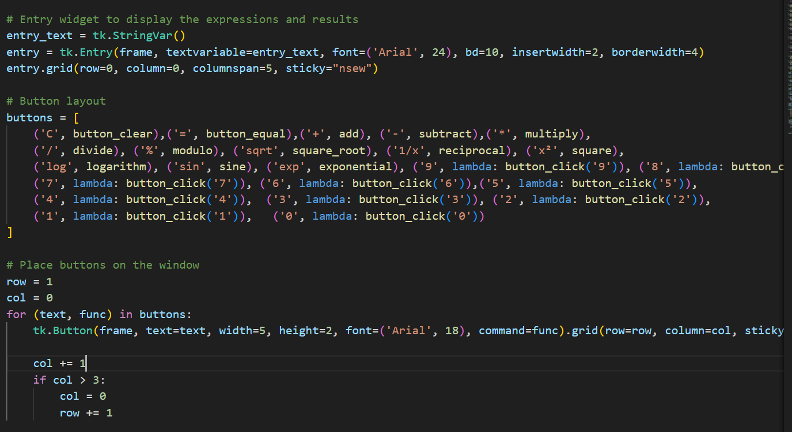
OUTPUT
“OUTPUT”

Slide 8
CONCLUSION . We created a basic calculator application using Python’s Tkinter library. .Emhasize how the GUI is designed for user-friendliness. .Describe the testing methods employed to ensure accuracy and reliability

Slide 9
THANK YOU
Conclusion and future improvements
Summery:- The key points of the calculator project were discussed
Future Enhancements:- potential improvements include adding more advanced functions and refining the UI.

